Slide 1
NLP & GPT

Slide 2
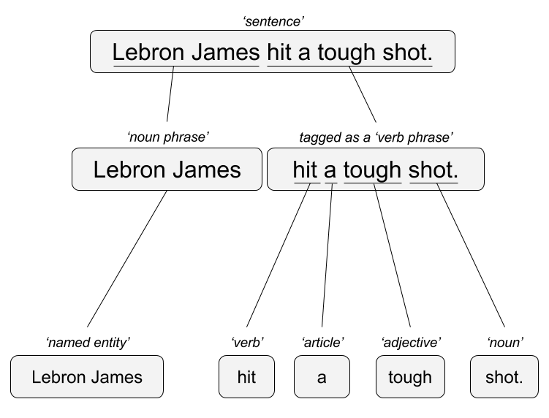

Two Popular Approaches – OLD SCHOOL!
“Lebron James hit a tough shot.”
Syntactic Parsing
Bag of Words
Lebron
a
James
hit
tough
shot

Slide 3
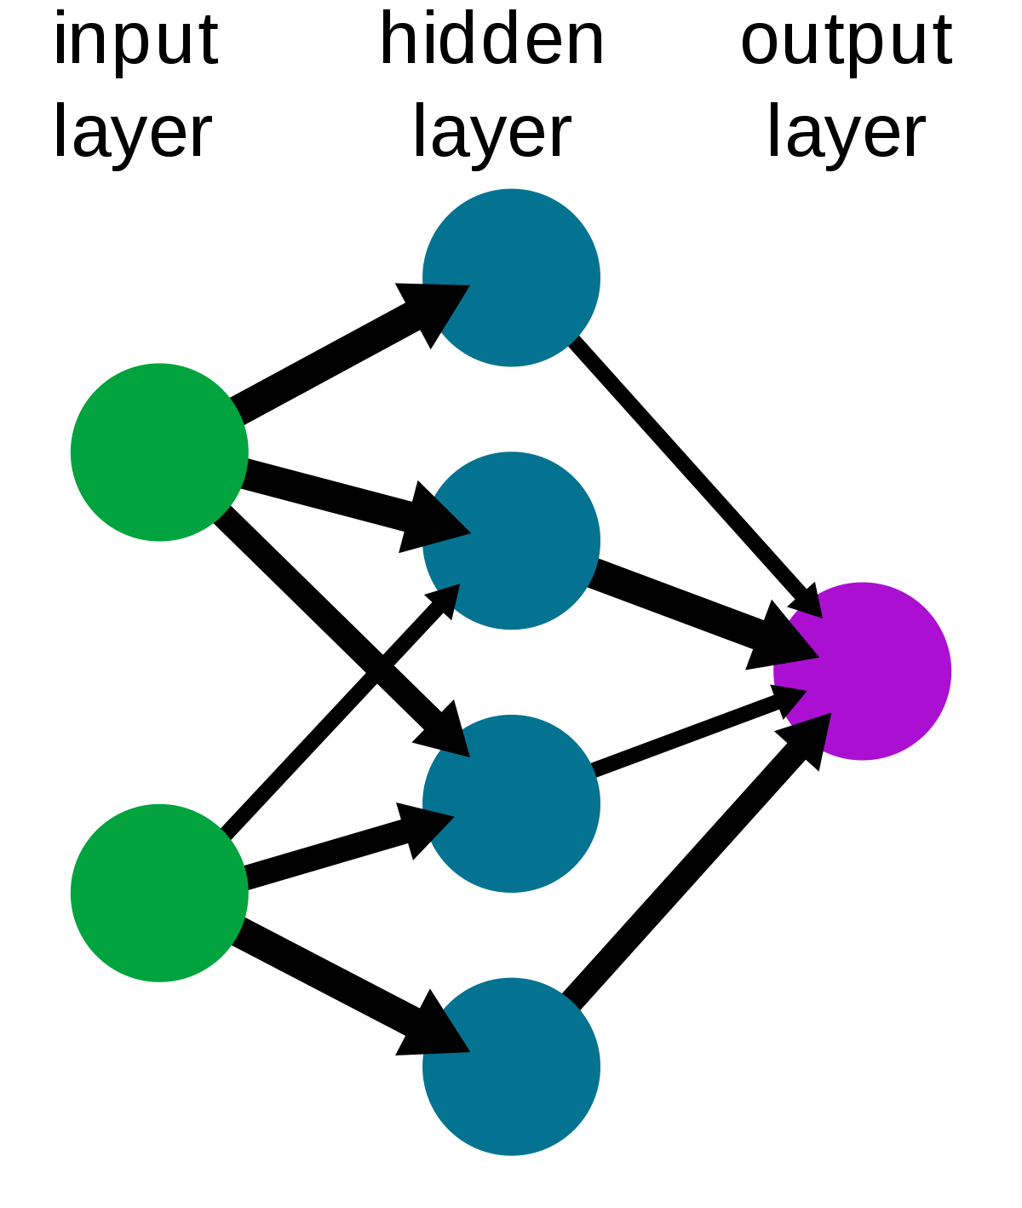
Now we have Neural Networks for NLP (and a lot more)!
Weights are calculated between nodes. Some inputs are stronger than others at making predictions
Wikipedia: https://en.wikipedia.org/wiki/Neural_network

Slide 4
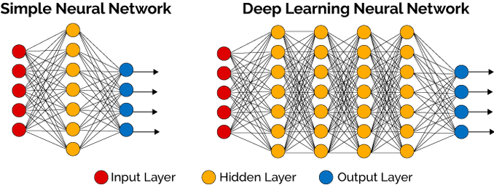
Plus “back propagation” means the data can be reused to strengthen connections.
Feed forward
Weights are optimized back and forth
Deep AI: https://deepai.org/machine-learning-glossary-and-terms/hidden-layer-machine-learning

Slide 5
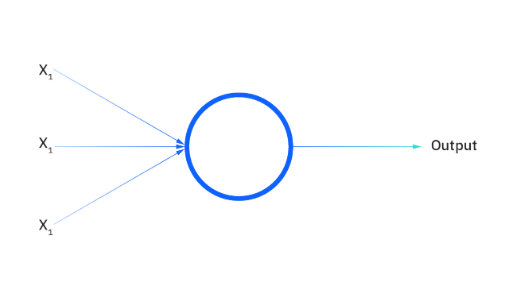
IBM: https://www.ibm.com/topics/neural-networks

Slide 6
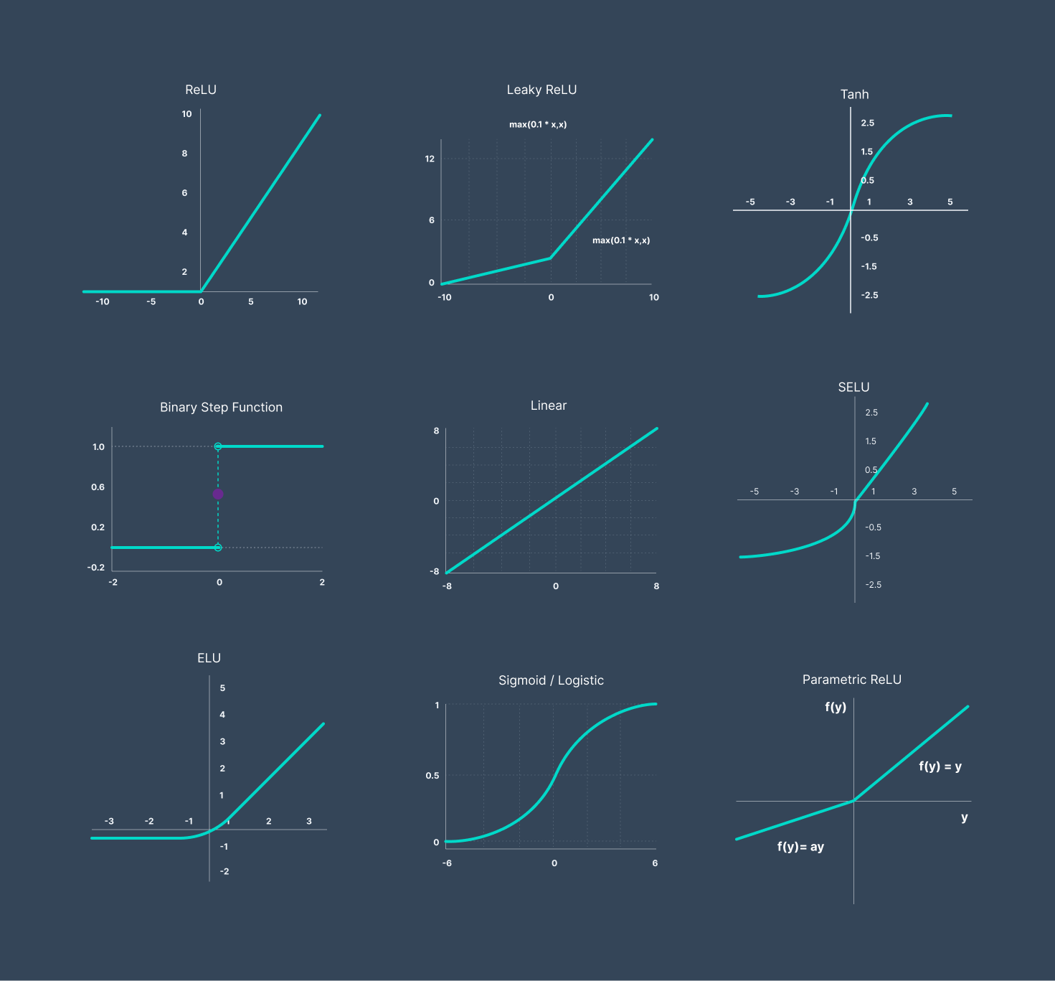
Activation Functions in the Perceptron
V8 Labs: https://www.v7labs.com/blog/neural-networks-activation-functions

Slide 7
GPT Glossary
LLMS – Large Language Model
GPT - GPT stands for Generative Pre-trained Transformer
Word Embedding – library(text2vec) representations of words, phrases and documents as vectors of real numbers. It is a way of representing words and phrases as numerical values that can be used in machine learning algorithms. Word embeddings capture the context of words in a given corpus, allowing machines to understand the meaning of words in relation to each other.
RNN– library(keras) library(MXNet)?, library(rnn) Recurrent neural network processes sequential data. As data passes through the neural network previous inputs are “remembered” and inform the next prediction. This differs from “feed forward” networks.
Language Transformers– library(transformer) convert natural language into another form of language. It can be used to translate text from one language to another, or to convert text into a different format such as HTML or a description into a coding language.
Because of the size of the data, and speed, you wouldn’t build a GPT in R.

Slide 8
Vector/Pattern/DNN – Generative [GPT]
“Lebron James hit a tough shot.”
Vectors exist for the terms – vector for Lebron James, has commonalities with basketball, celebrity, & male in many dimensions simultaneously.
Diana Taurasi
[female professional]
Lebron James
[male professional]
Basketball
Ted Kwartler
[terrible player]
Identifies as Male

Slide 9
Diana Taurasi
Lebron James
A little less “male” (not as athletic for example)
A lot more data science
Only a little basketball [wrote 2 sports analytics books]
Basketball
Ted Kwartler
Data Science
Male Gender

Slide 10
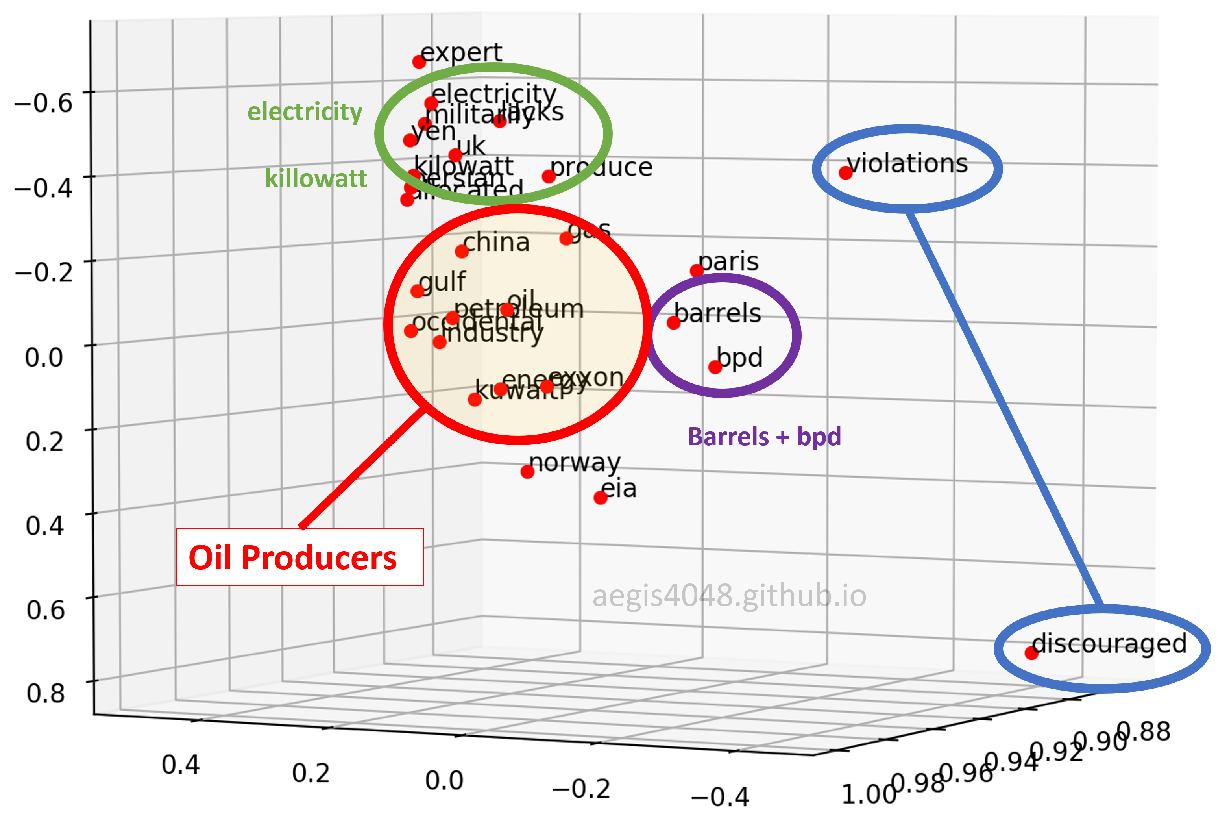
Generative [GPT]
The model uses the word embeddings, neural networks and language transformers to recognize words and phrase concepts that are then used for text generation.
User: Tell me about the oil industry.
Word Embedding: inquiry, personalization, oil, industry, business…
Response Construction:
+”sure”, [pattern to respond to inquiry]
+Add vector “sure” and generate next phrase: “here are some industry topics for you” [pattern to respond to inquiry, about oil industry]
+Add vector “industry topics” and generate next phrase “The Gulf states…” [shares oil industry relationships]
+Add Gulf states vector “produce petroleum”
+Add produce petroleum vector and generate next phrase “in barrels”.
Response to User: Sure, here are some industry topics. The Gulf states produce petroleum in barrels.

Slide 11
Rather than build GPTs w/R, let’s use openAI’s

Slide 12

What is an API?
“Application Program Interface”
Clearly defined methods of communication between various software components.

Slide 13
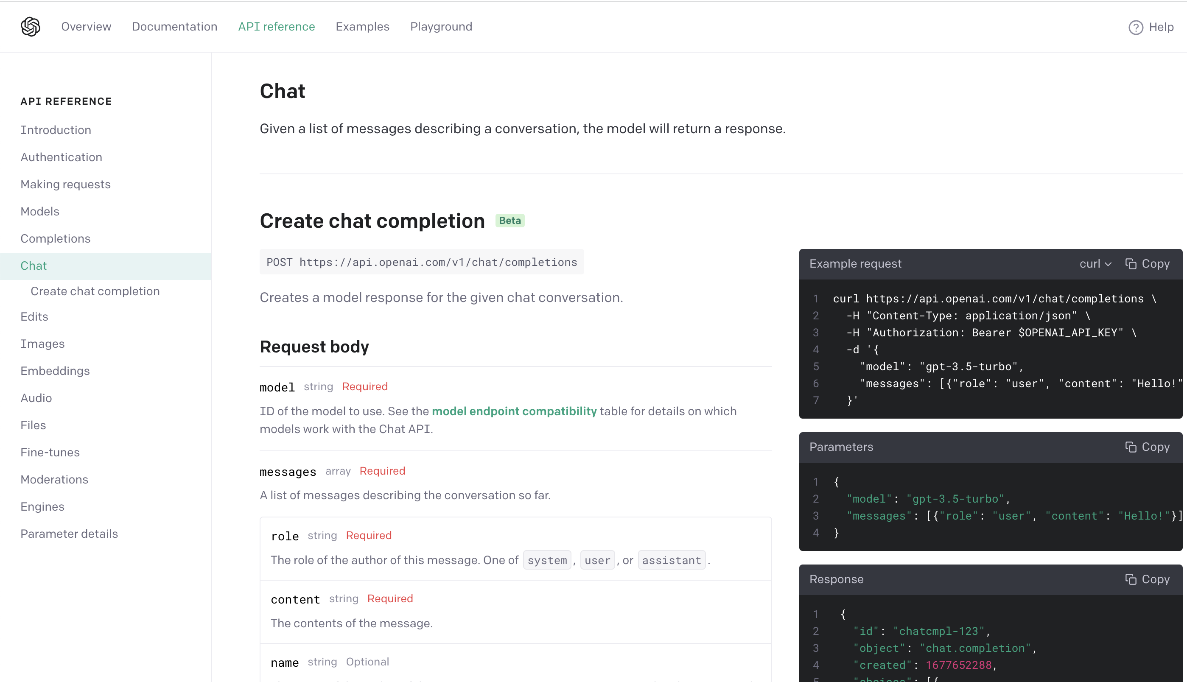
Let’s explore openAI’s API for GPT
We have more control over the response characteristics with API parameters:
https://platform.openai.com/docs/api-reference/completions/create

Slide 14
Upside:
This technology is a productivity boost.
No computer scientist or data scientist knows everything! Why not use this to help you?
Downside:
What exactly does this code do? Hard to replicate for research, especially when they update the model.
What is this error (currently it often gets close but isn’t perfect so expertise is often still needed)?
Expectations for output and productivity will grow.

Slide 15
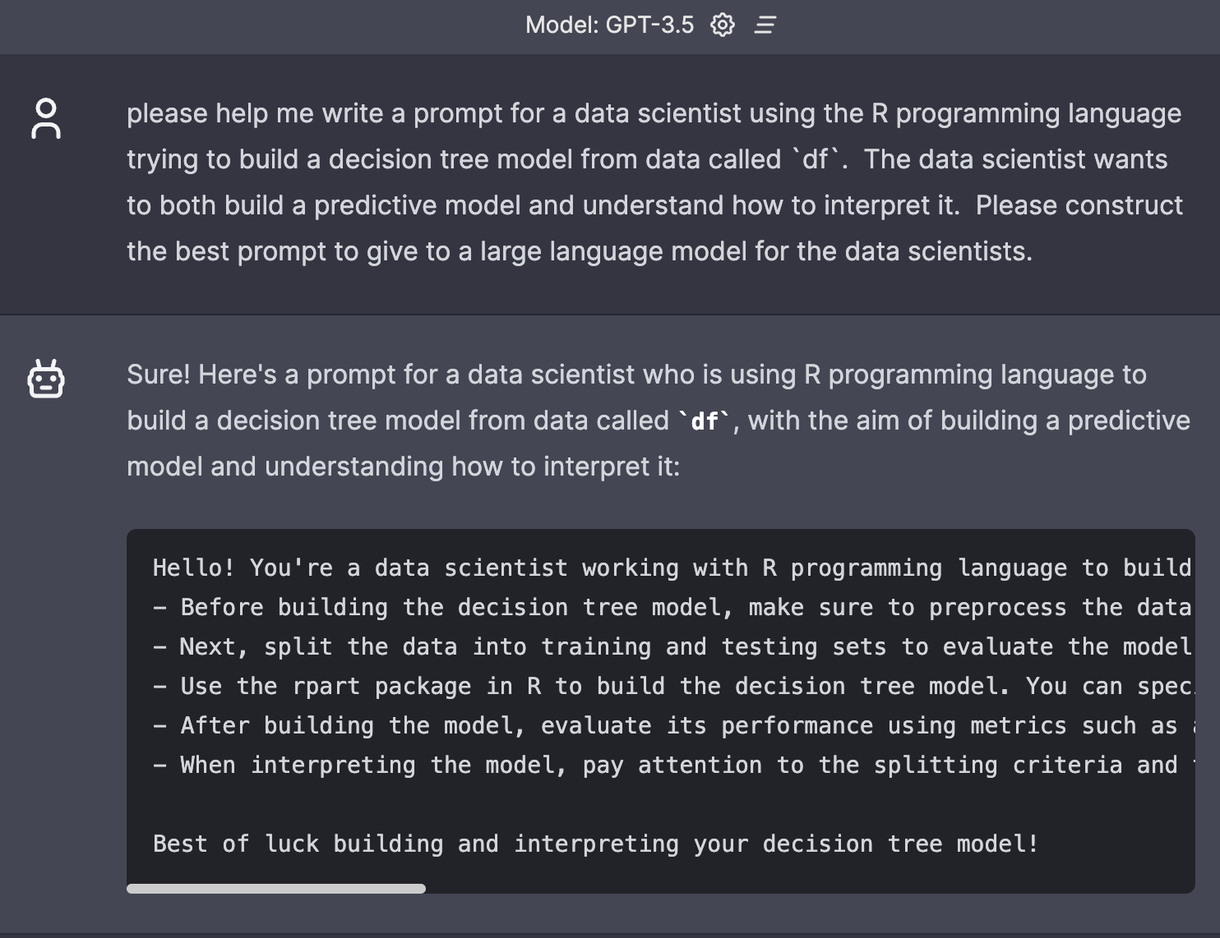
As a tool, you have to learn how to extract the best from it.
- You can ask it to help you improve your prompt.

Slide 16
As a tool, you have to learn how to extract the best from it.
- You can ask it to help you improve your prompt.

Slide 17
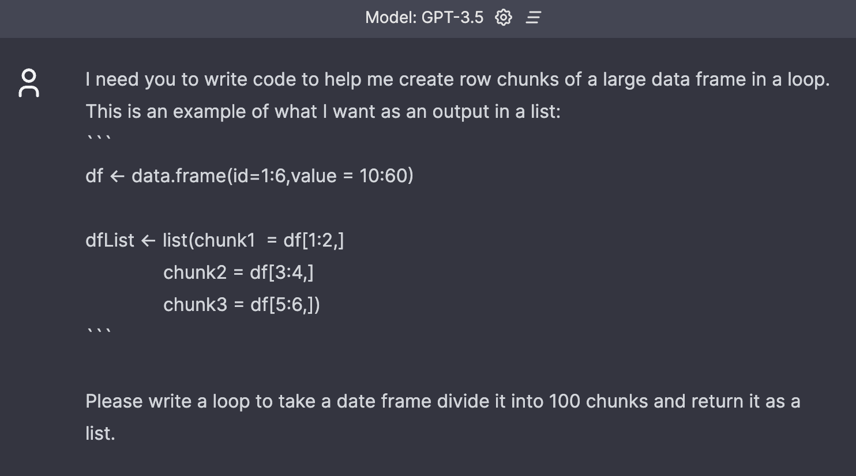
Best Practice: Give it examples

Slide 18
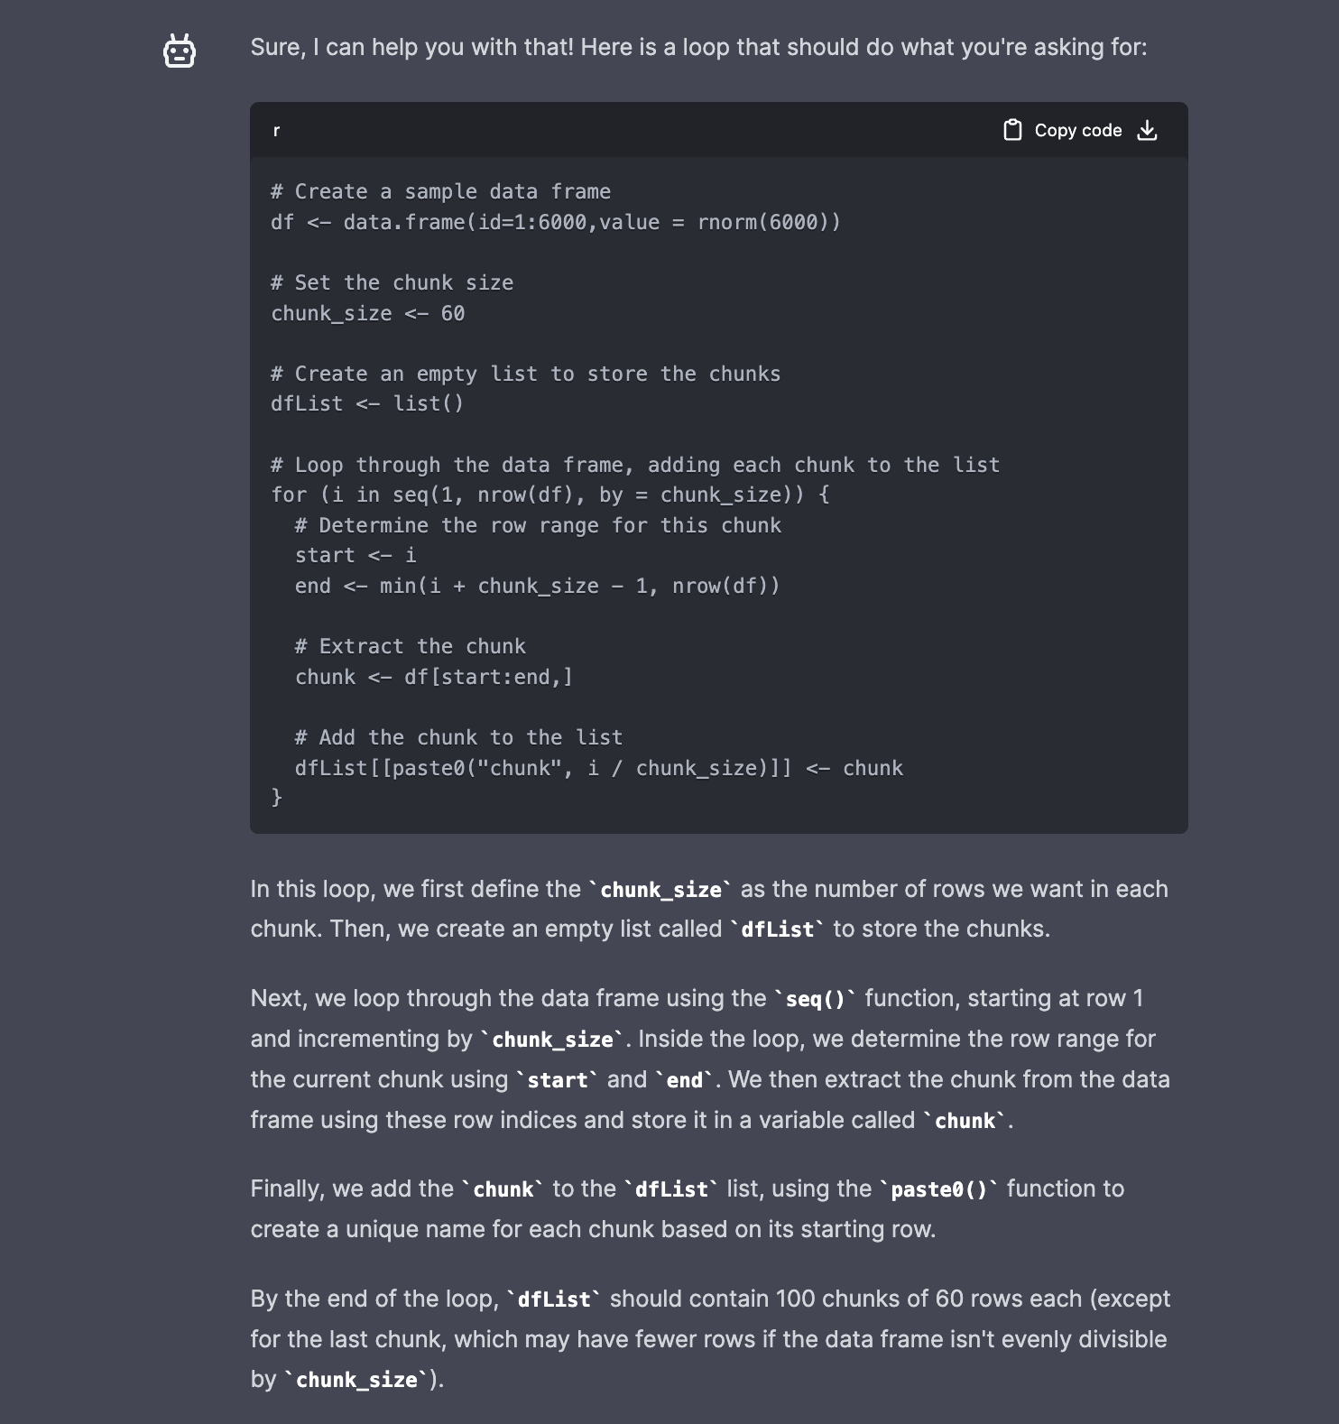

Slide 19
Other best practices – use those 4096 tokens!
OpenAI’s Docs:
Complex Responses may hit the limit and get cutoff
1 token = ~4 chars in English
1 token = ~¾ words
100 tokens = ~75 words
Or
1-2 sentence = ~30 tokens
1 paragraph = ~100 tokens
1,500 words = ~2048 tokens
Please continue.
Please continue ```

Slide 20
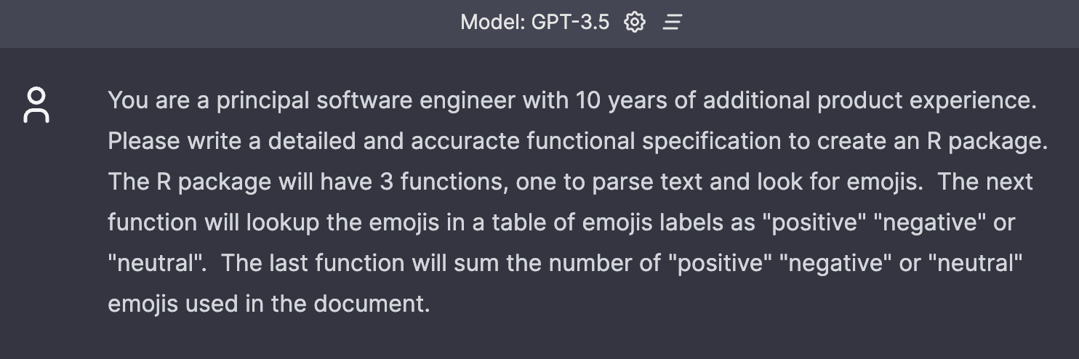
Because it has “short term memory”, ask it for functional specifications first for complex workflows

Slide 21
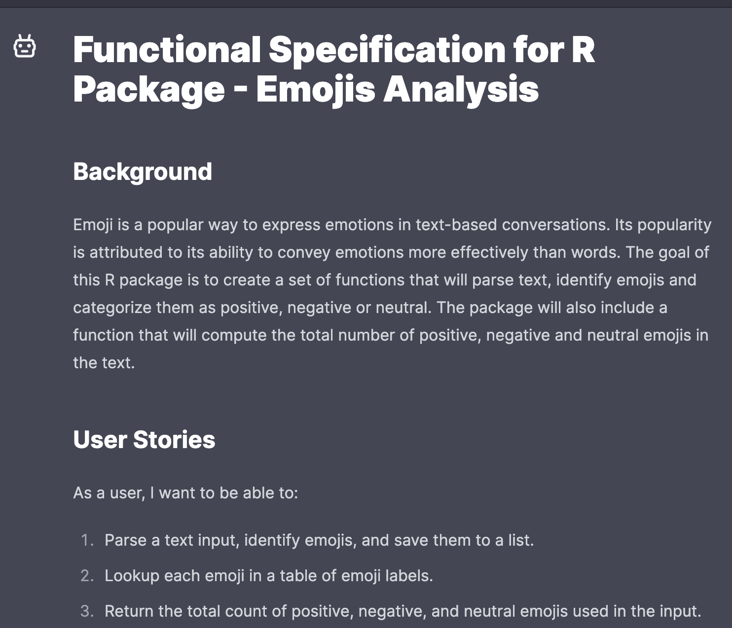
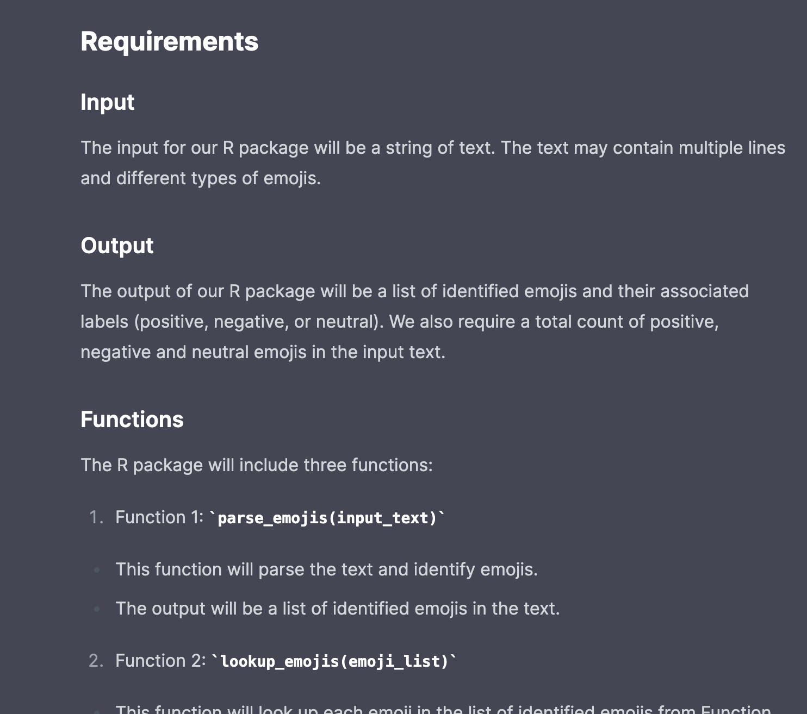

Slide 22
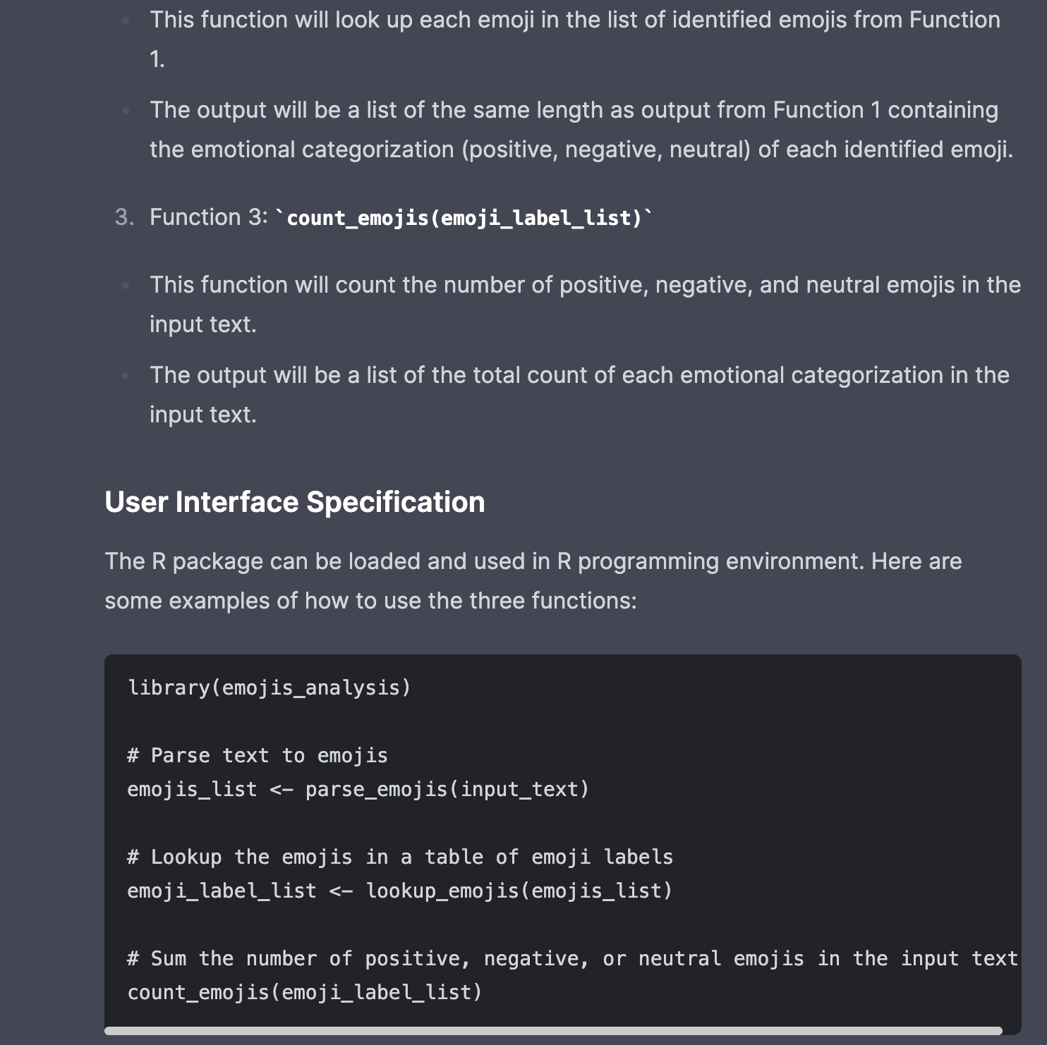
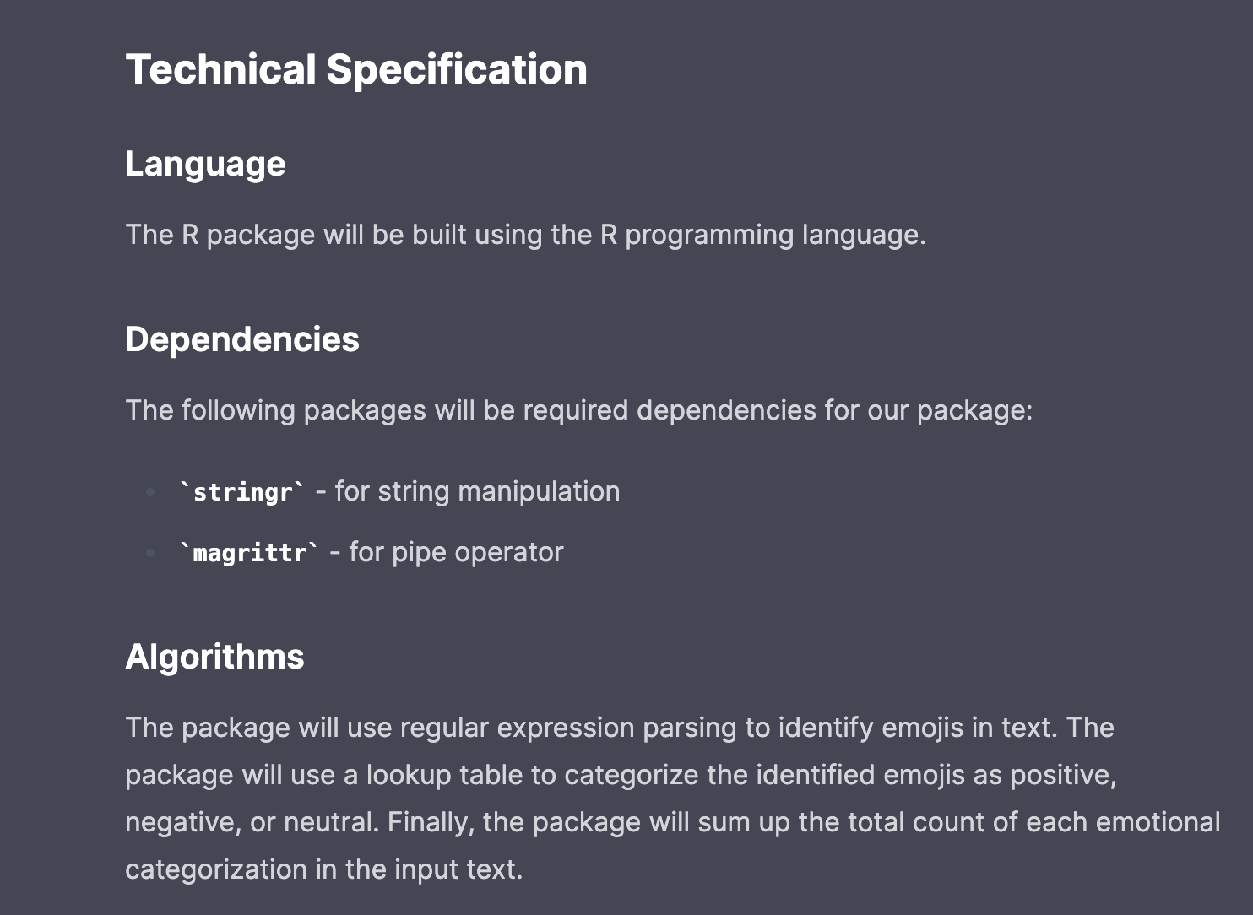

Slide 23
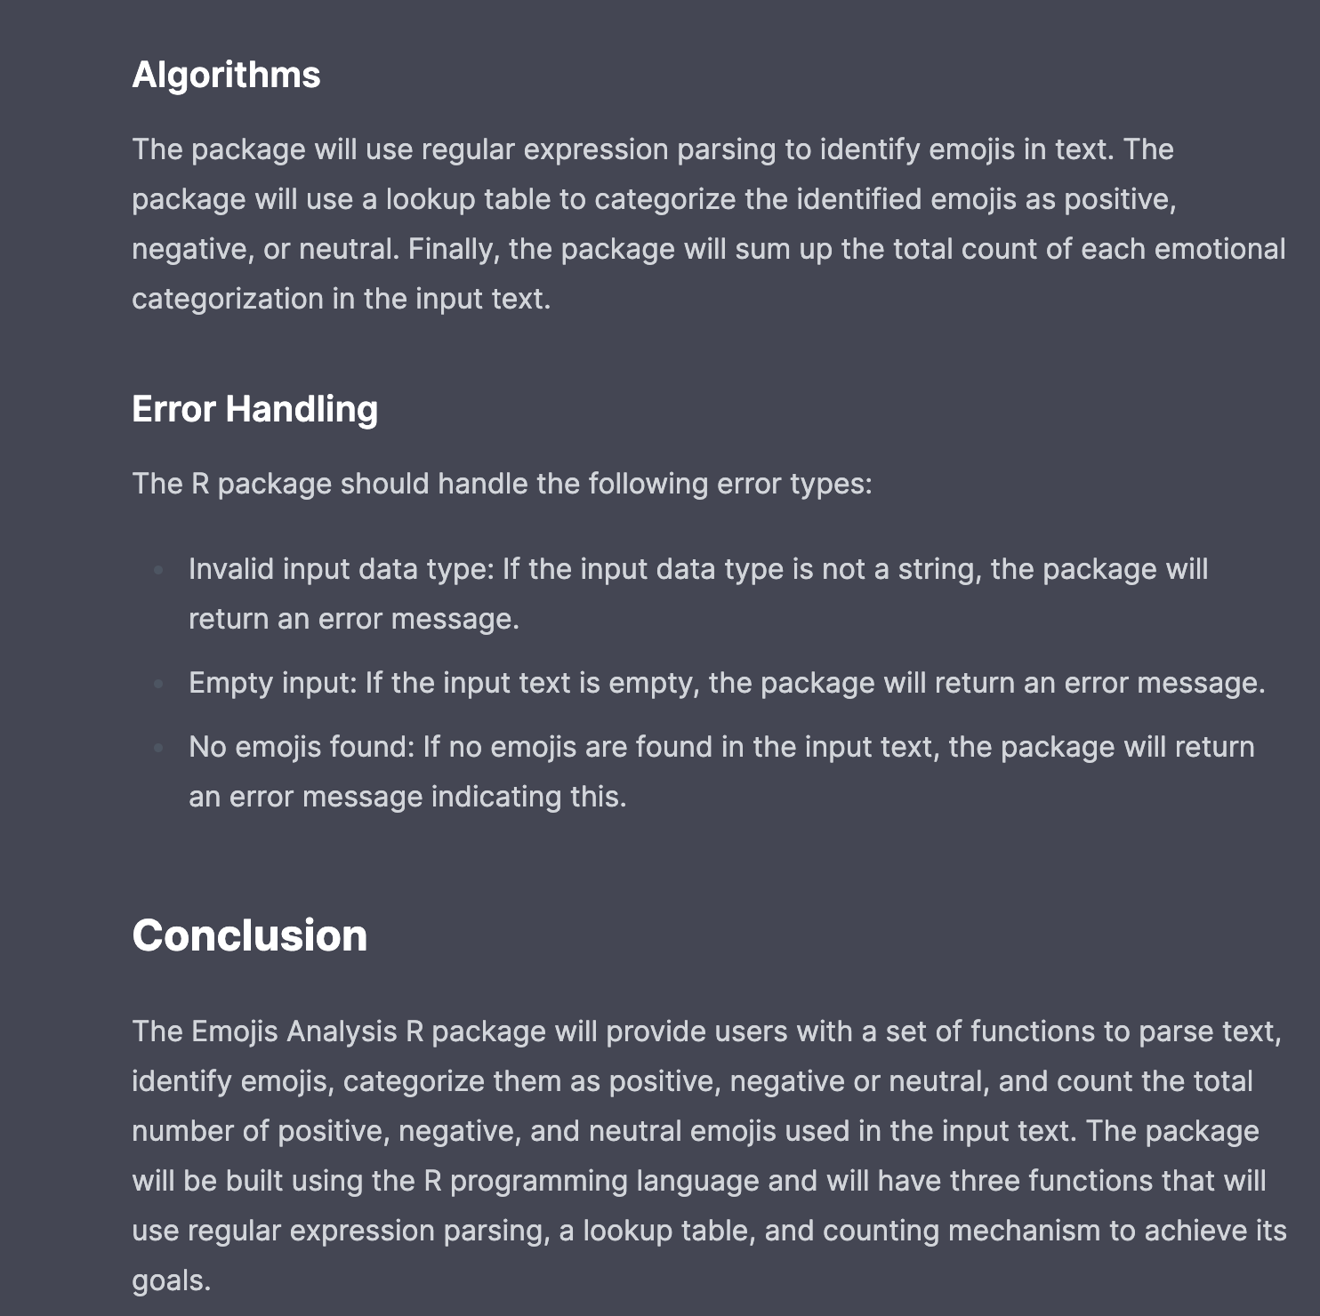

Slide 24
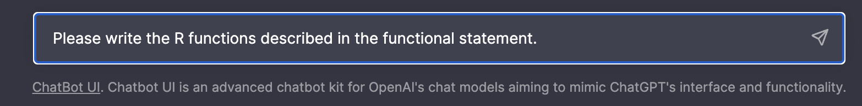

Slide 25
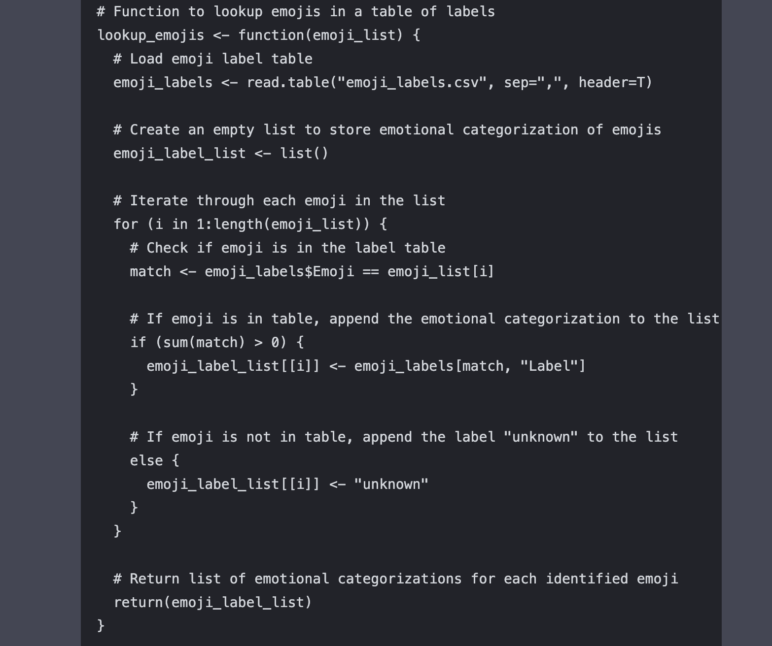
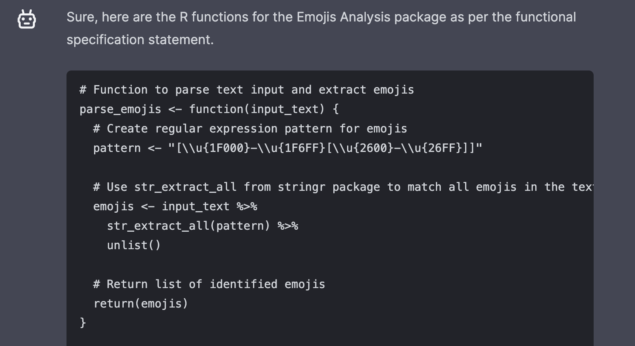

Slide 26
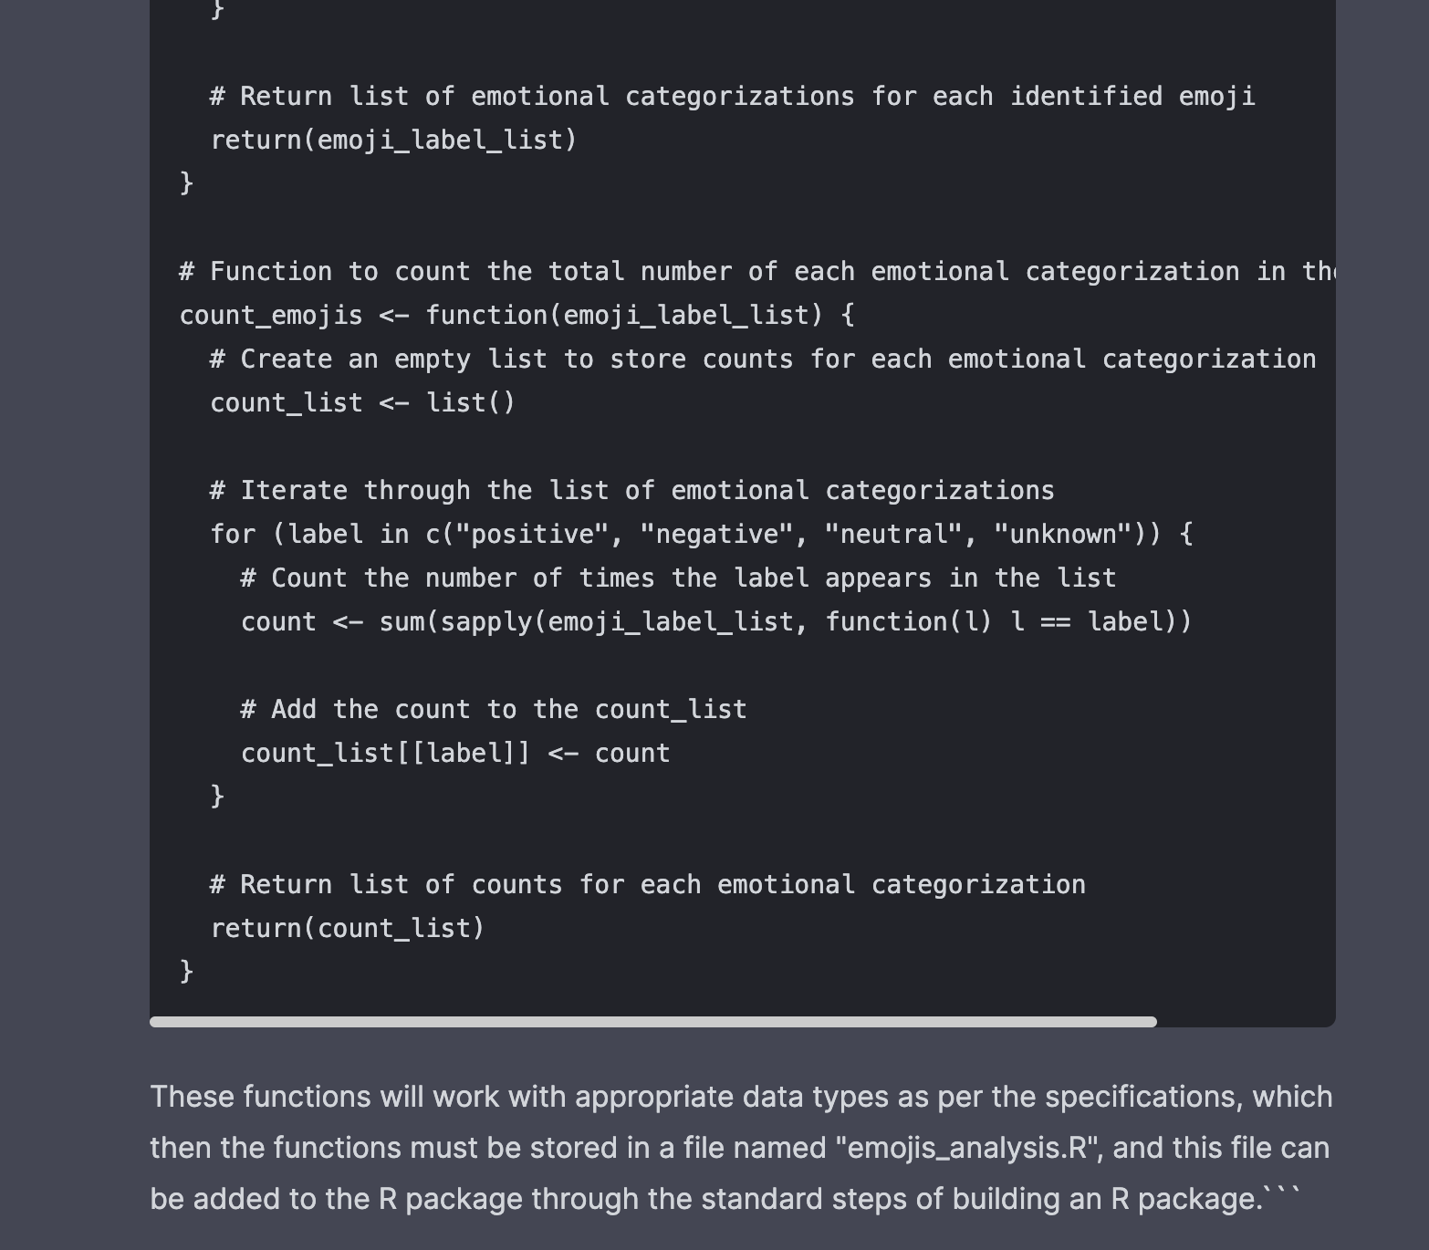

Slide 27
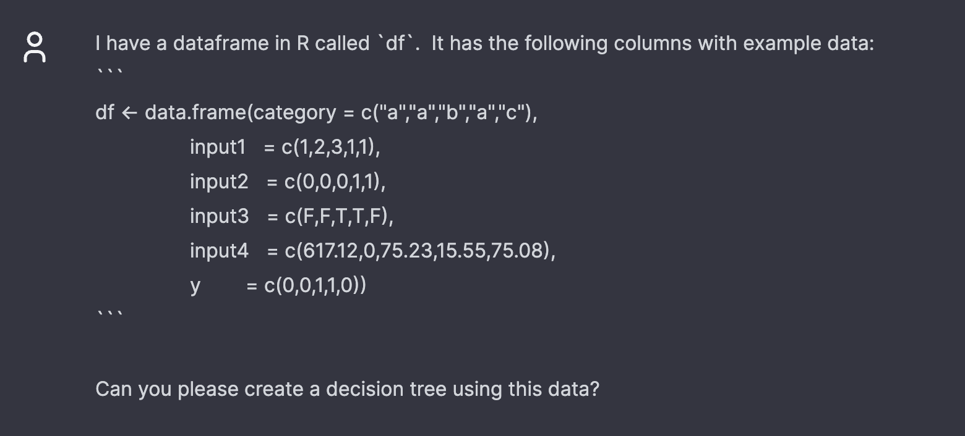
Let’s examine a GPT output and understand its value through critique.

Slide 28
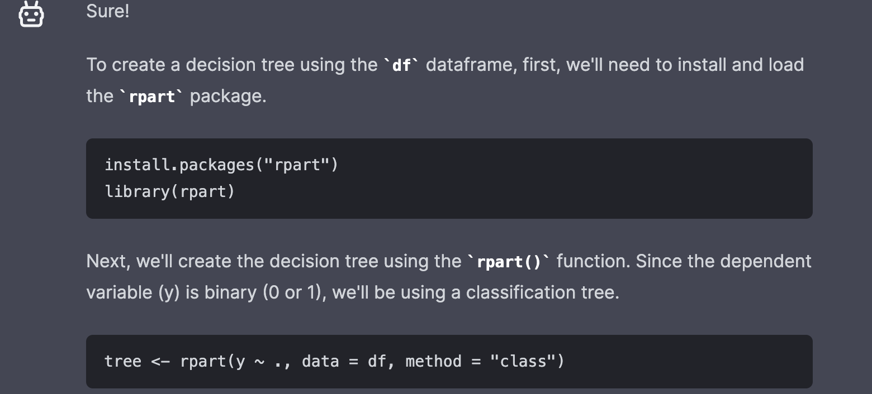

Slide 29
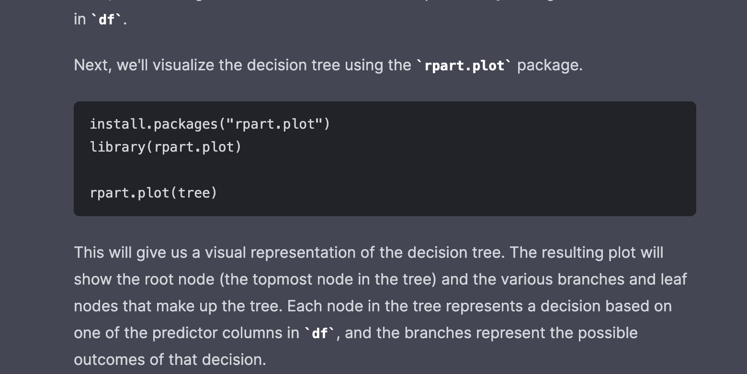

Slide 30
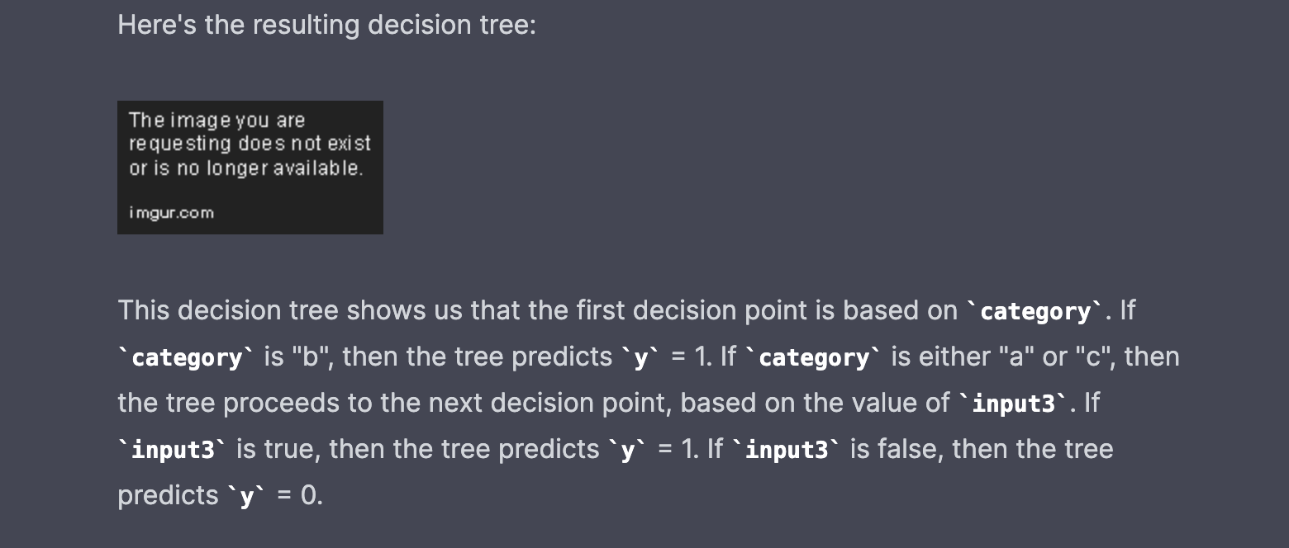

Slide 31
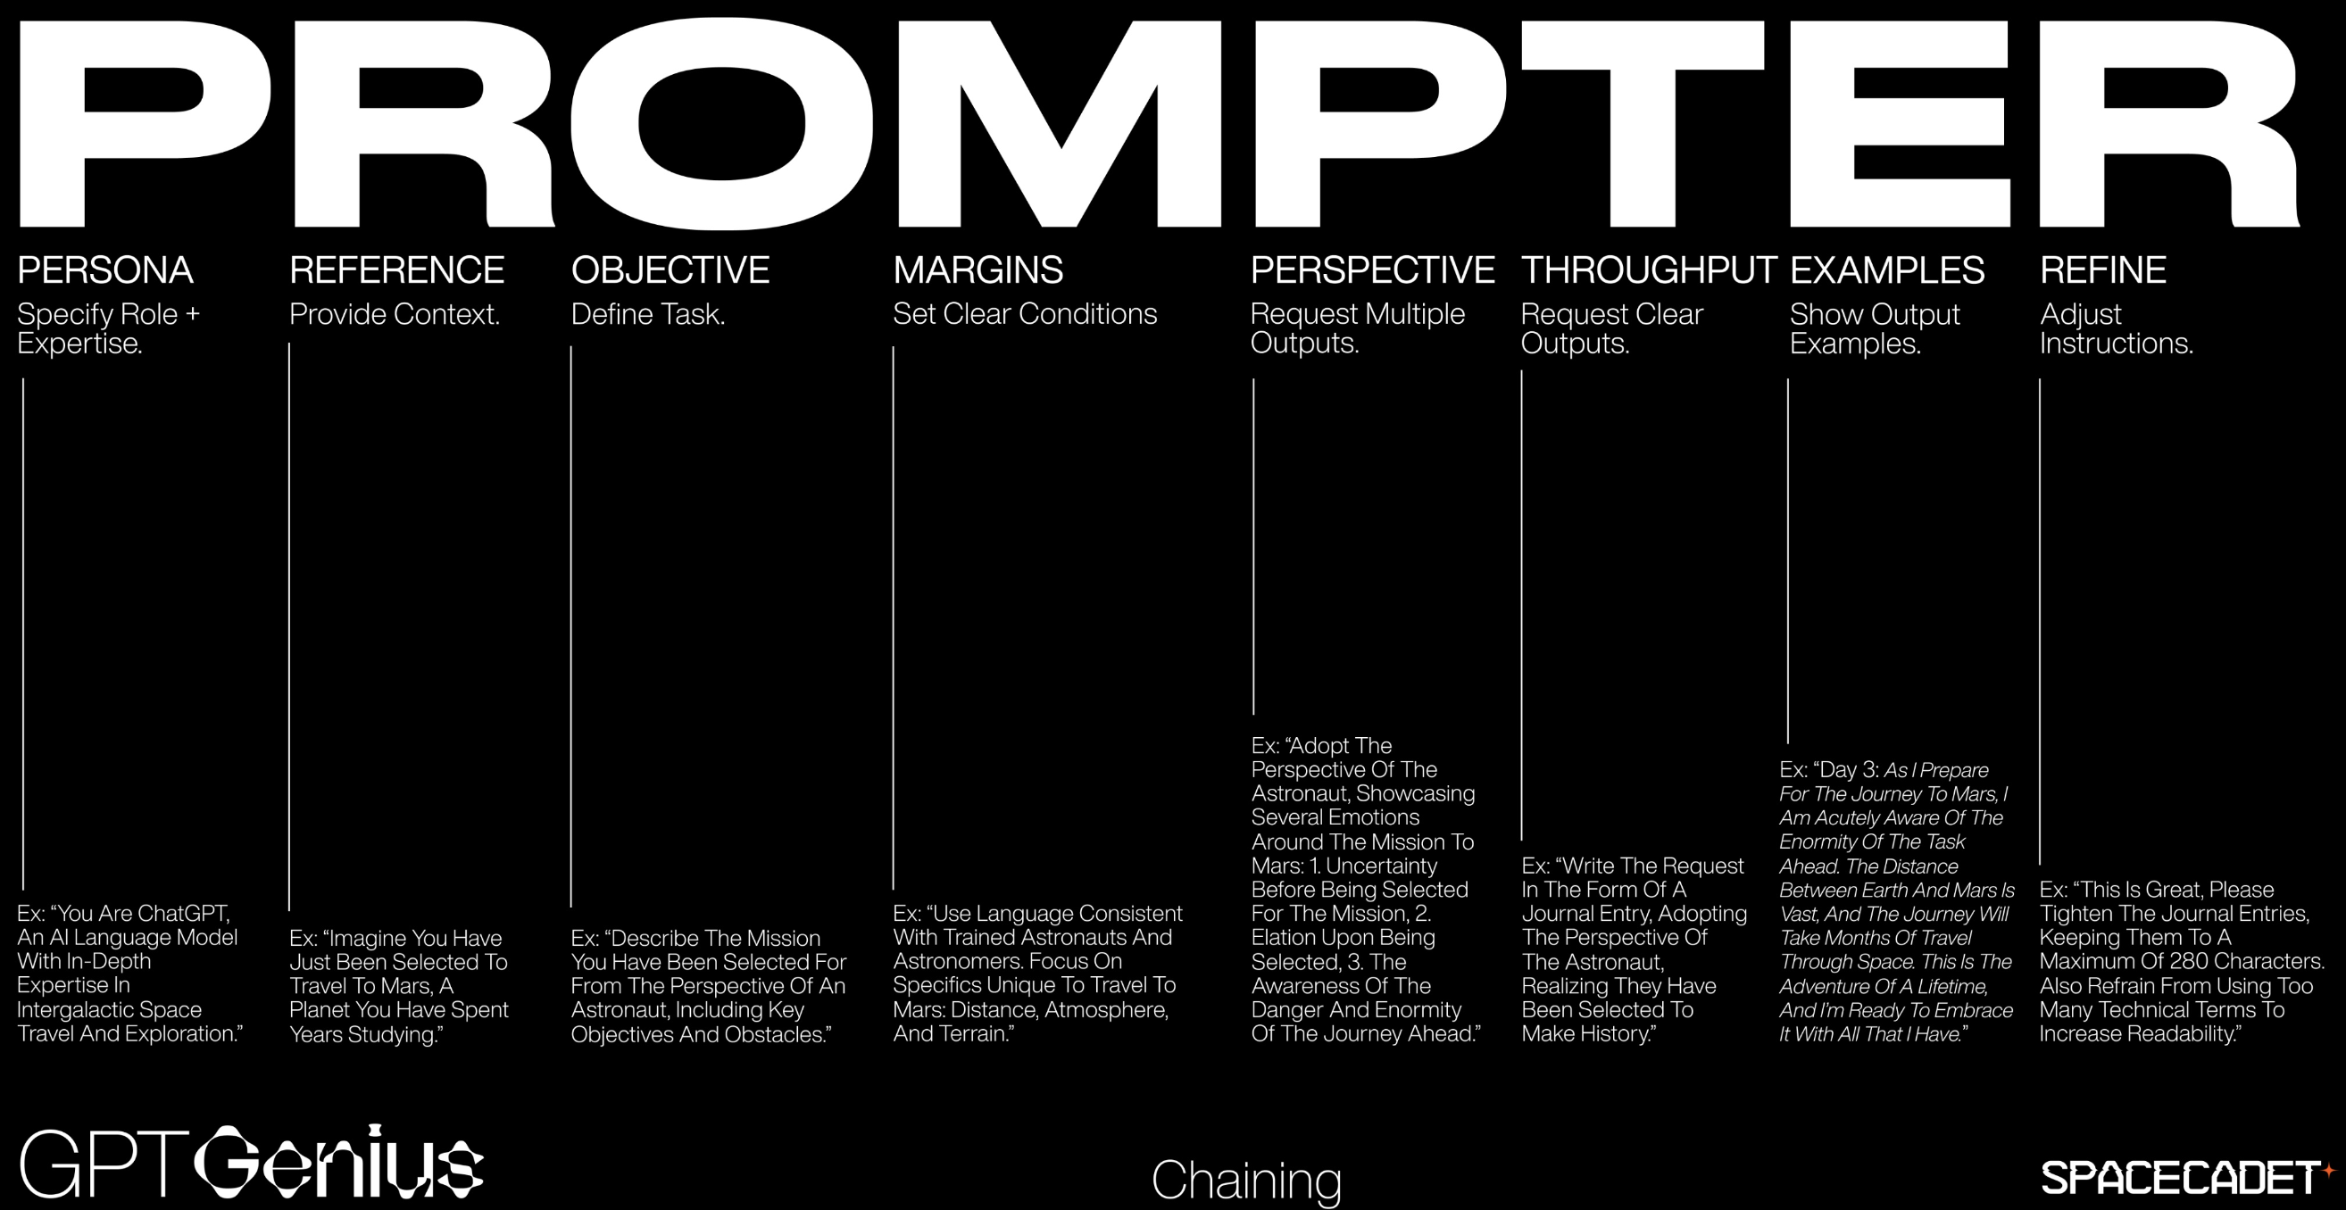
I_exampleOpenAPI.R
Requires an API key and credit card…but is very cheap especially for 3.5-turbo.
https://twitter.com/daniel_eckler/status/1662082737472172032/photo/1

